Slide 1
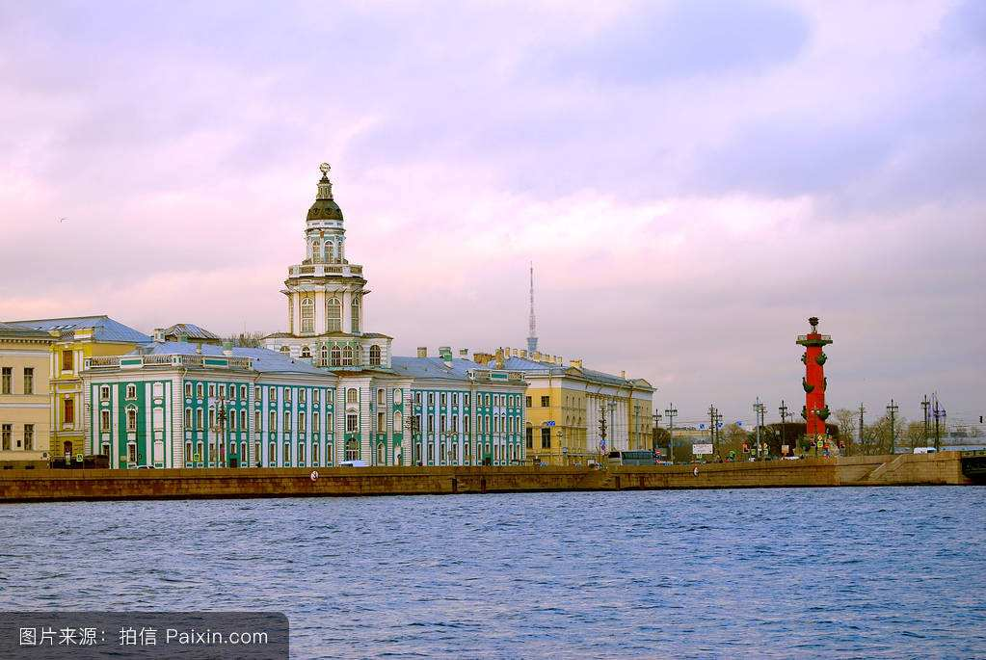
Passage B
A Russian Experience
（Para.1-Para.2）
17照明艺术 黄雪纯
201707413051

Slide 2
Background information
St.Petersburg
St.Petersburg, the second largest city in Russian, was founded in1703 by Emperor Petrograd in 1914. Ten years
later , the city’s name changed again ,this time to Leningrad. The in 1991, Leningraders voted to resore the
city’s original name.

Slide 3
para.1-para.2
It was almost midnight, yet the streets were bathed in a soft, shimmering(闪烁的) light. The sun had just gone down and twilight（暮光；黄昏） would soon give way to night. We were strolling along （漫步）the Nevsky Prospekt, a wide avenue stretching four kilometres and filled with people, music and street entertainers（街头艺人）. This was St Petersburg in August and it seemed the city was out to celebrate the long summer nights. We had just left the home of newly found Russian friends and after a wonderful traditional dinner decided to have some exercise before going to bed.
It has always been my dream to visit St Petersburg. Absorbed by Russian history since childhood, I wanted to see it all for myself. Now, thanks to Perestroika, tourists are welcomed into Russia and St Petersburg with its rich, cultural history is a popular choice.

Slide 4
几近午夜了,街道还沐浴在柔和的暮色微光之中。夕阳刚刚西下,黄昏过后夜幕即将降临。我们正漫步在涅夫斯基大街上。这是一条绵延4公里的宽阔大道,行人和街头艺人熙熙攘攘,音乐声不绝于耳。这就是八月的圣彼得堡。人们似乎倾城而出,庆祝这漫漫的夏日长夜。我们刚离开新结识的俄罗斯朋友的家。在享用了一顿丰盛的传统晚餐之后,我们决定就寝前稍稍活动一下。
到圣彼得堡一游一直是我的梦想。童年时我就沉迷于俄罗斯历史,一直希望能够亲眼目睹它的风采。现在,多亏了改革政策,俄罗斯才向观光者张开了双臂。而圣彼得堡由于它那丰厚的文化历史底蕴,自然成为观光者的首选必游之地。

Slide 5
Time: almost midnight
Sun: had just gone down
Nevsky Prospekt:
Stretching four kilometers
Filled with people , music and street entertainers
Resident:
Be out to celebrate summer nights

Slide 6
According to the author，the attraction of St.Petersburg to tourists is mainly its（）
A
cutural history
B
elegant buildings
C
street entertainers

Slide 7
Language Point
give way to（yield to；become loosened）
Decaying forces give way to new rising forces.
Your argue with yourslef , and your manditation has to give way to your preconceived ideas.

Slide 8
Language Point
Stretch
to spread over a large area or distance;
(cause to)become longer or wider.
He yawned and stretched.
They’re used to stretching their budgets.

Slide 9
Language Point
Stretch
at a stretch across 一下子
stretch across 延伸穿过
during a stretch 在一段时间里
along a stretch of road 沿着一段路
stretch out (平躺；伸出) stretch yourself out 躺下（通常为休息或睡觉）
stretch a point 破例；通融
at full stretch 竭尽全力

Slide 10
Language Point
Absorb v.
to make someone greatly interersted in;
to take or suck (something)in,esp.gradually;
to reduce the effect of a shock ,force,change.
1.I was completely absorbed by this novel.
2.The banks would be forced to absorb large losses.
3.We can’t absorb those costs.

Slide 11
徐杨
1
CULTURE
2
TEXT
3
WORD AND GRAMMAR

Slide 12
Paragraph 3
We flew in form Stockholm and form the air immediately noticed a well-planned city with apartment blocks built in semicircles with central courtyards and gardens. Not only did this seem practical, but the idea behind the design was to shelter residents form the fierce winter winds. || The city was built by European architects in the 18th and 19th centuries and remains one of Europe’s most beautiful cities. || Straddling the wide River Neva, the city is made up of almost 50 islands connected by some 310 bridges. No wonder the sight of elegant buildings along the canals reminded me of Paris, Amsterdam and Venice.

Slide 13
WORD
fly in : 降落，乘飞机旅行
fly into: 突发
block: n.块，街区
v.阻止，阻碍
blocked: adj.阻塞的，被封锁的
Build in:插入，嵌入
Build into:使固定于，建设成
semicircle：半圆形
shelter…..form…
protect….form…
practical:实际的，实用的

Slide 14
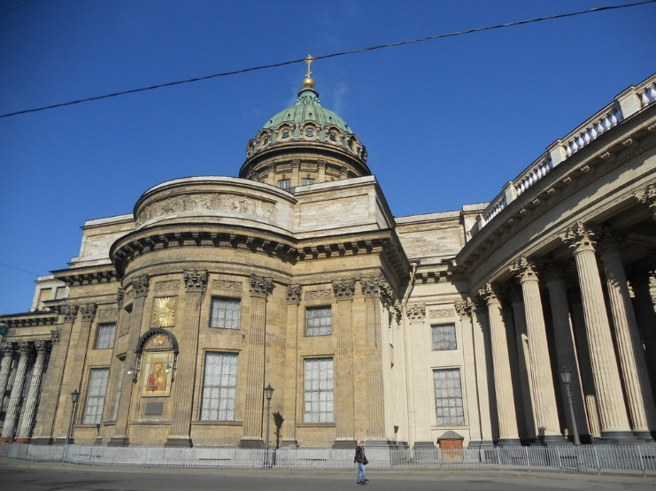
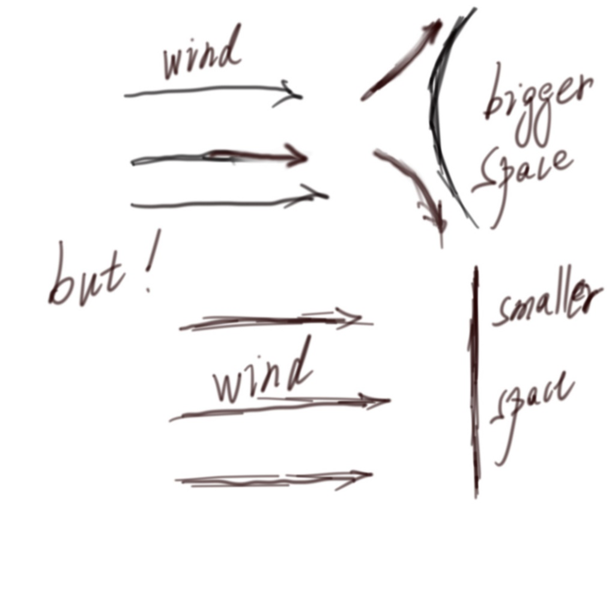
点击输入内容

Slide 15
Paragraph 3
We flew in form Stockholm and form the air immediately noticed a well-planned city with apartment blocks built in semicircles with central courtyards and gardens. Not only did this seem practical, but the idea behind the design was to shelter residents form the fierce winter winds. || The city was built by European architects in the 18th and 19th centuries and remains one of Europe’s most beautiful cities. Straddling the wide River Neva（涅瓦河）, the city is made up of almost 50 islands connected by some 310 bridges. No wonder the sight of elegant buildings along the canals reminded me of Paris, Amsterdam and Venice.

Slide 16
WORD
remain: v&n
remains: n
straddle: n.跨坐
v.跨，骑
be made up of
=consist of
be made of/form
elegant: adj.高雅的，优雅的

Slide 17
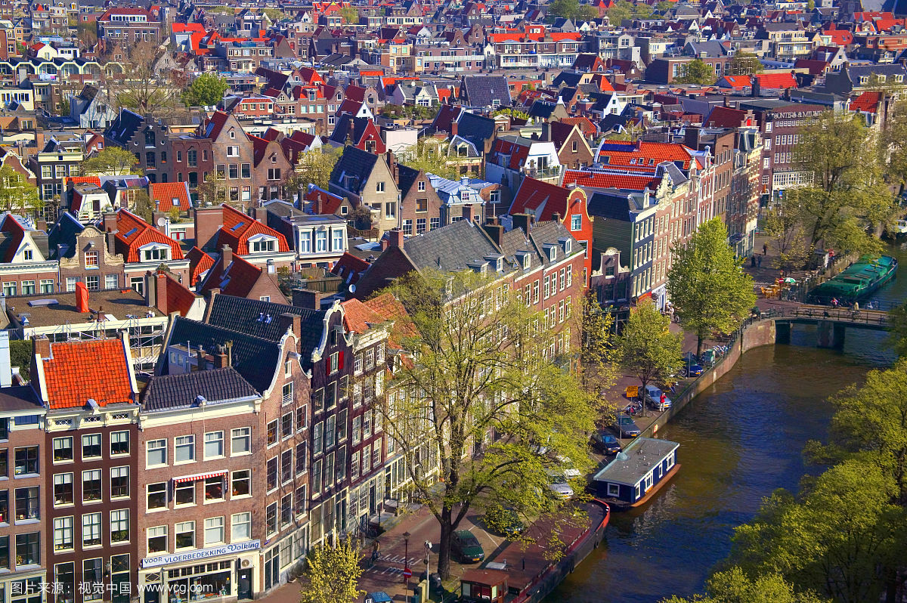
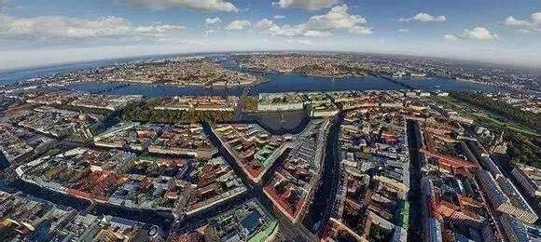
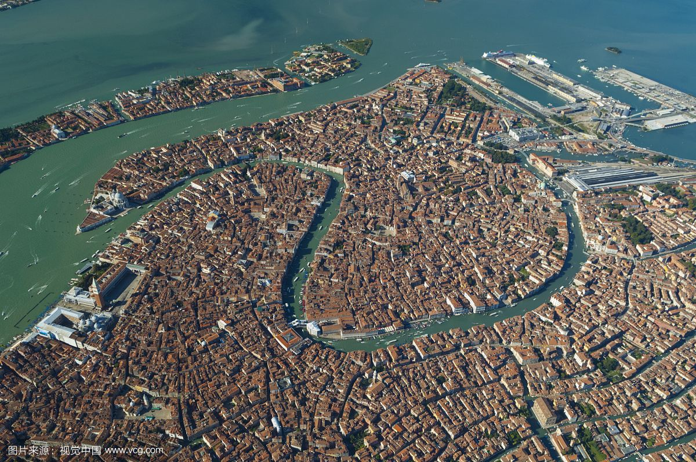
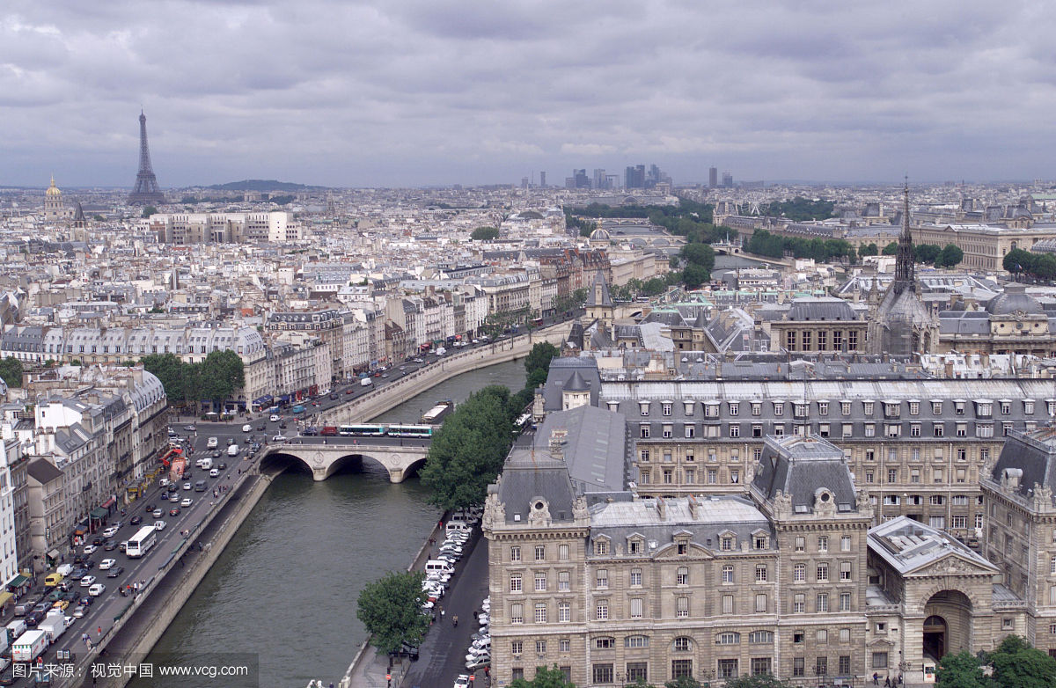
St.Petersburg
Venice
Amsterdam
Paris
点击输入内容

Slide 18
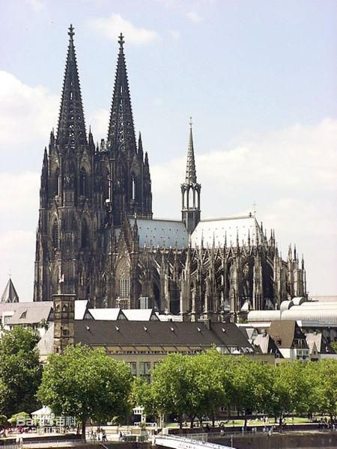
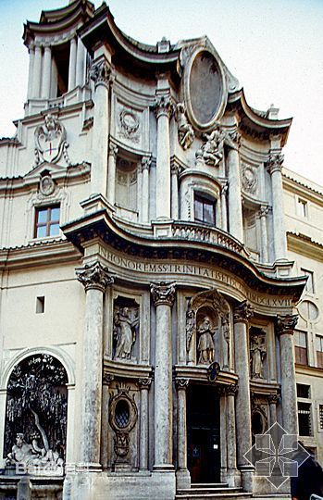
look down from above
bird's-eye view
get a bird's-eye view
UAV(unmanned aerial vehicle)
无人机
Petersburg（American）
St.Petersburg（Russian）
美国圣彼得堡
俄国圣彼得堡
Gothic architecture
topping mysterious religious
Baroque architecture
巴洛克建筑
magnificent weird（怪异的） exaggerated（夸张的）
点击输入内容

Slide 19
4
paragraph

Slide 20
The text
热情的
强烈的
I hadn't met many Russian people but I had an intense love for their country and traditions and was passionate about art and literature. Russian writers such as Pushkin, Tolstoy, and Dostoevsky reach the very soul of ordinary Russians, and this I find intriguing. It was no different when I finally found myself in Russia. People were openly friendly and eager to discuss any aspect of their lives in their beloved Motherland. No matter how bad the economy, somehow these people have the ability to see the positive aspects of their lives, whatever their circumstances. We met an attractive woman from Moscow, and we fast became friends and it was she who invited us into the home of some dear friends of hers.
有趣的
迷人的

Slide 21
Three authors present to this paragraph and their productions
Pushkin
Dostoevsky
《战争与和平》
《安娜·卡列尼娜》
《黑暗的势力》
《复活》
《自由颂》
《致恰达耶夫》
《假如生活欺骗了你》
《黑桃皇后》
《女房东》
《脆肉的心》
《罪与罚》
《群魔》
Tolstoy

Slide 22
Words
beloved
S
a. dearly love
eg.
She was forced to leave her beloved Paris and return to Lyon.
Eric was a gifted and beloved teacher over the years.
positive
T
a.
Hopeful and confident , or giving cause for hope and confidence
eg. Life doesn’t always run smoothly but you’ve got to be positive and make the best of it.
2. Without any doubt ; certain
eg. It is suspected that he committed the crime , but there isn’t any positive proof.

Slide 23
Translation of Two sentences
ENGLISH
It was no different when I finally found myself in Russia.
CHINESE
现在我终于如愿以偿来到俄罗斯，而此时，她对我的魅力丝毫不减。
ENGLISH
No matter how bad the economy, somehow these people have the ability to see the positive aspects of their lives, whatever their circumstances.
CHINESE
不管经济如何糟糕， 不管境况如何艰难，他们总能够乐观应对他们的生活。

Slide 24
特殊句式
It was she who invited us into the home of some dear friends of hers.
1. 陈述句的强调句型
It is/ was + 被强调部分（通常是主语、宾语或状语）+ that/ who（当强调主语且主语指人）+ 其他部分.
eg. It was yesterday that he met Li Ping.
2. 一般疑问句的强调句型
Is/Was it +被强调部分+ that/ who+其他部分.
eg. Was it yesterday that he met Li Ping?
3. 特殊疑问句的强调句型
被强调部分（通常是疑问代词或疑问副词）+ is/ was + it + that/ who + 其他部分？
eg. When and where was it that you were born?

Slide 25
paragraph 5-6
荆薇

Slide 26
Paragraph 5
The apartment block was in an elegant area of St Petersburg and was probably a palace in the past but now converted into apartments of four floors.The entrance through a narrow hallway was dark and dull and there was an old fashioned lift on the ground floor with steel folding gates that clanged shut,after which the lift moved very slowly upwards.It was quicker to walk up the staircase.
apartment
block

Slide 27
Paragraph 5
The apartment block was in an elegant area of St Petersburg and was probably a palace in the past but now converted into apartments of four floors.The entrance through a narrow hallway was dark and dull and there was an old fashioned lift on the ground floor with steel folding gates that clanged shut,after which the lift moved very slowly upwards.It was quicker to walk up the staircase.
apartment
block

Slide 28
The apartment block was in an elegant area of St Petersburg and was probably a palace in the past but now converted into apartments of four floors.
（我们所去的公寓大楼地处圣彼得堡一个高尚住宅区,昔日或许是一座宫廷宅院,现在它被改建成了4层公寓。）

Slide 29
My hometown is (where) and it located in (...) of China.It was (...) in the past.But now (...)
(where) is a (...) area of China and it was(...)in the past but now(...)
Push
Simplify

Slide 30
some good words......
The apartment block was in an elegant area of St Petersburg and was probably a palace in the past but now converted into apartments of four floors.

Slide 31
elegant adj. 优美的;漂亮的;简炼的;简洁的(侧重于人为的高雅)
eg.
She brought in a tray heavy with elegant sandwiches, scones and cakes.
她端进来一只盘子，里面盛满了精美的三明治、烤饼和蛋糕。
He is elegent in behavior and firm in action.
他是个举止文雅但行动坚决的人。
graceful adj. 优美的，优雅的;得体的;(侧重于自然的、天生的优美)
eg.
The dancers were all tall and graceful.
这些舞蹈演员都个子高高的，动作十分优雅。
the graceful curves of the hills
连绵起伏的丘陵美景

Slide 32
convert v. （使）转变;使皈依;兑换，换算;侵占;使...改变信仰
eg.
The signal will be converted into digital code.
信号会被转变为数字代码。
If you try to convert him, you could find he just walks away
如果你试图改变他的信仰，他就会走开。
convert 一般只表示事物的外表及用途等方面发生的次要变化,而不是本质上的巨大变化,也可用于改变某人的政治观点、信仰.
alter 指物体表面或局部做部分变动,而没有变成另一种事物。或事物性质、位置、大小、形状等变化。也指人的外表的变化
change 改变,变更,指位置,性质,外表,形式或是数量与质量等改变.常与into连用.

Slide 33
Paragraph 5
The apartment block was in an elegant area of St Petersburg and was probably a palace in the past but now converted into apartments of four floors.The entrance through a narrow hallway was dark and dull and there was an old fashioned lift on the ground floor with steel folding gates that clanged shut,after which the lift moved very slowly upwards.It was quicker to walk up the staircase.
apartment
block

Slide 34
The entrance through a narrow hallway was dark and dull and there was an old fashioned lift on the ground floor with steel folding gates that clanged shut,after which the lift moved very slowly upwards.
(进门后穿过狭窄的门厅,光线又黑又暗;在底楼有一部老式电梯,它的钢质折叠门在关闭时哐铛作响,然后电梯缓缓上行)

Slide 35
There was (something) on (something). And it (...) ,then (...)
there was (...) with (...) that (...),after which (...).
optimize
（优化）
combine
(结合)

Slide 36
some good words......
The entrance through a narrow hallway was dark and dull and there was an old fashioned lift on the ground floor with steel folding gates that clanged shut,after which the lift moved very slowly upwards.
dark and dull 又黑又暗
clang 叮当（或铿锵）作响

Slide 37
Paragraph 6
the host
Our host,Yuri Petrochenkov,himself an artist,warmly greeted us at the door.He was tall with gray hair pulled into a tail.His open,friendly manner and twinkling eyes showed a sense of humor and his English with a thick accent made him an entertaining host.Nelly,his wife,spoken little English but understood a great deal more.

Slide 38
Paragraph 6
the host
Our host,Yuri Petrochenkov,himself an artist,warmly greeted us at the door.He was tall with gray hair pulled into a tail.His open,friendly manner and twinkling eyes showed a sense of humor and his English with a thick accent made him an entertaining host.Nelly,his wife,spoken little English but understood a great deal more.

Slide 39
Our host,Yuri Petrochenkov,himself an artist,warmly greeted us at the door.
Nelly,his wife,spoken little English but understood a great deal more.

Slide 40
(name) is a (...) ,and she/he is our (...).He(...).
our (...),(name),(oneself) a (...身份...) ,(...description...).
(name),(...who...),(...description...)

Slide 41
Paragraph 6
the host
Our host,Yuri Petrochenkov,himself an artist,warmly greeted us at the door.He was tall with gray hair pulled into a tail.His open,friendly manner and twinkling eyes showed a sense of humor and his English with a thick accent made him an entertaining host.Nelly,his wife,spoken little English but understood a great deal more.

Slide 42
some good words......
His open,friendly manner and twinkling eyes showed a sense of humor and his English with a thick accent made him an entertaining host.

Slide 43
a sense of (+ n.) ......感
eg.
The passing of time brought a sense of emptiness.时间的流逝带来了一丝空虚感。
He felt a sense of relief that his part in this business was now over.
现在不再参与这门生意了，他如释重负。
make sb. (+n.) 使/让(...成为...)
eg. He made her his wife. 他娶她为妻。
let's make it a deal 让我们做个交易/ 让我们做个保证。
You make me a fool. 你把我当傻子啊。

Slide 44
Paragraph
7
Para5—8: The author got warm welcome and was entertained heatedly
In Yuri’s and she had an enjoyable time.

Slide 45
Paragraph 7
Part.1
We were ushered into their main room, which served as(充当) a living-room, dining room and TV area. There was an air of intimacy in the room, as though it was the core part(核心部分) of this family. Many parties, social and political discussions and family gatherings take place here.

Slide 46

Translation
我们被引进他们家的主厅,这里实际是客厅、餐厅和看电视的地方。房间里有一种亲密的气氛,似乎它是这个家里最核心的地方。许多聚会、社会政局讨论和家庭团聚都在这里举行。

Slide 47
Key points
intimacy:n.亲密;亲近
usher:v.引领，招待;做招待员;宣告
n.引座员;招待员;门房;助理教员
usher into:领进，引入
pl.Usher Sino-Japanese friendship into the 21st century .
把中日友好关系推向21世纪

Slide 48
Paragraph 7
Part.2
We were honored to be there and I felt ashamed that I had absolutely no Russian language to attempt to communicate in. Why is it（强调句的特殊疑问句形式） that people of the English-speaking world take for granted that the rest of the world should speak English? I had always meant to learn Russian and had enrolled for courses in the past but they never started because of lack of numbers.

Slide 49
Translation
到此一访真是荣幸之至。不过,遗憾的是我对俄语一窍不通,根本别想用它来与人交谈。英语世界的人们为什么理所当然地认为世界的其他地方都应该说英语呢?以前,我一直想学俄语,过去也曾在几个学习班报过名,但都因为人数不够而无法开课。

Slide 50
key points
enroll
attempt to
E
A
领进，引入
v.招收;注册;登记;加入
尝试，企图;试图做某事
He failed in his attempt to take
control of the company.
take for granted
mean to do
T
M
to believe without even thinking about i
认为…理所当然, 想当然;轻信
We take for granted the things that
we should be giving thanks for.
打算做；有意做
Don't be too hard on the boy,
he didn't mean to do it.
mean to:意味着，对…很重要

Slide 51
Paragraph8-9
Zheng WenBo
201707413037

Slide 52
Read about it
Our meal was a feast in itself. We weren‘t offered wine, just vodka in little shot glasses and before drinking there is always a toast. Some（大约） nine vodkas later, Yuri was in fine form and had found a drinking partner in my husband!
Translation
我们的晚餐异常丰盛。我们喝的不是葡萄酒，而是倒在小杯里的伏特加。喝酒前通常总要敬酒。大约喝了九杯伏特加后，尤里仍然意犹未尽，和我丈夫真是酒逢知己！

Slide 53
Language Points
Shot glass
A
A tiny drinking glass ,
usually for strong alcoholic drinks.
一口一杯
In fine form
1.But he has started this campaign in fine form, with five league goals to his name already.
2. The count（伯爵） was in fine form during the meal.
Stress in itself is not necessarily injurious（有害的）.
That in itself is not unusual. 强调
B
状态不错，非常到位
In itself
C
本身;在本质上，完全地

Slide 54
Read about it
Wandering along the river, we agreed that not only had we found new friends, but we had just spent probably the most enjoyable experience of our trip to Russia. This is what travel is all about - to get to the heart and soul of the people and to try to understand and experience a little of what makes others tick.
Translation
沿河漫步，我们一致认为，我们不仅结交了新的朋友，而且还体验到了或许是此次俄罗斯之行中最愉快的经历。而这正是旅游的全部意义所在--接触人们的心灵并且努力去理解和体验些许他人的生活与行动准则。

Slide 55
Language Points
tick
A
1.His exercise books were full of well deserved red ticks
2. He wanted to find out what made them tick
他想搞清楚他们为什么会那样。
1. This is what compassion is all about.
n. 壁虱；勾号；一瞬间；嘀嗒声
v. 发出嘀嗒声；在纸上打勾；做出…举动
This is what travel is
B
This is sth. sth.是表语 表语从句
现在what是充当了sth.,在这句子当中是作为宾语补足语

Slide 56
Thank you!

